Slide 1
PAPER 3
學生: 林奇鋒

Slide 2
Paper Outline
Introduction
Methodology
Feature Selection
Structure Learning
Model
Machine Learning
Methodology for Financial Application
Experiment
Experiment 1
Experiment 2
Experiment 3
Discussion and Conclusion

Slide 3
Machine Learning

Slide 4
Machine Learning
Particle Swarm Optimization
V.S
Bee Colony Optimization
V.S
Ant Colony Optimization

Slide 5
Machine Learning
Particle Swarm Optimization

Slide 6
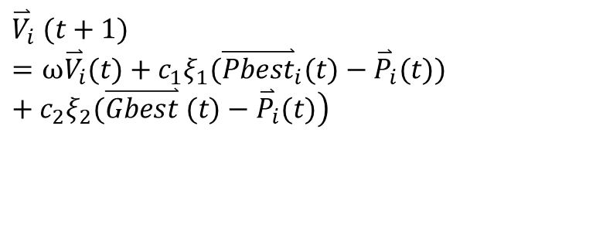

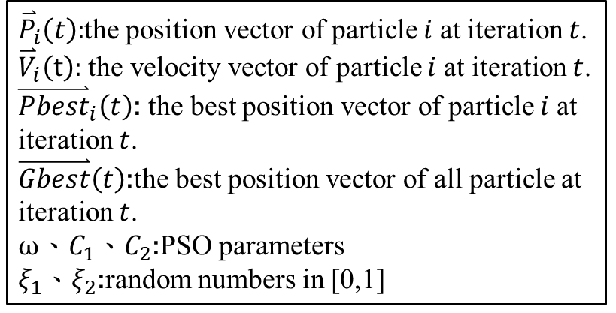

Particle Swarm Optimization
$$\left.{\overset{⃑}{V}}_{i} (t+1)=ω{\overset{⃑}{V}}_{i}(t)+c_{1}ξ_{1}({\overset{⃑}{Pbest}}_{i}(t)−{\overset{⃑}{P}}_{i}(t))+c_{2}ξ_{2}(\overset{⃑}{Gbest} (t)−{\overset{⃑}{P}}_{i}(t)\right)$$
全群最佳位置
(Gbest)
新位置
自我最佳位置
(Pbest)
透過自我最佳位置
調整方向
$${\overset{⃑}{P}}_{i}\left(t+1\right)={\overset{⃑}{P}}_{i}\left(t\right)+{\overset{⃑}{V}}_{i}\left(t+1\right)$$
透過全群最佳位置
調整方向
${\overset{⃑}{P}}_{i}\left(t\right):$the position vector of particle $i$at iteration $t$.
${\overset{⃑}{V}}_{i}\left(t\right):$ the velocity vector of particle $i$at iteration $t$. ${\overset{⃑}{Pbest}}_{i}\left(t\right)$: the best position vector of particle $i$at iteration $t$.
$\overset{⃑}{Gbest}\left(t\right)$:the best position vector of all particle at iteration $t$.
$ω、C_{1}、C_{2}$:PSO parameters
$ξ_{1}$、$ξ_{2}$:random numbers in [0,1]
慣性方向
目前位置
第$i$顆粒子

Slide 7



Particle Swarm Optimization
Initialize swarm
Start Iteration
Construct Fuzzy set
Prepare A、y
Calculate Firing-Strength
Initialize $P_{0}、 {\overset{⃑}{\text{θ}}}_{0}$
Calculate RMSE
Calculate Aim Of Object
Update$P_{k+1}$
Update Gbest、Pbest
Recursively
Update ${\overset{⃑}{\text{θ}}}_{k+1}$
Update Velocity
Calculate Output
Update Position
Get Consequences parameters
No
STOP?
Yes
End

Slide 8
Machine Learning
Ant Colony Optimization

Slide 9
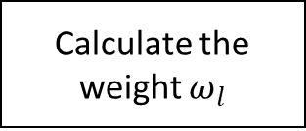
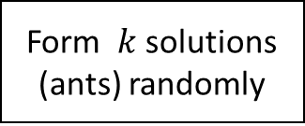
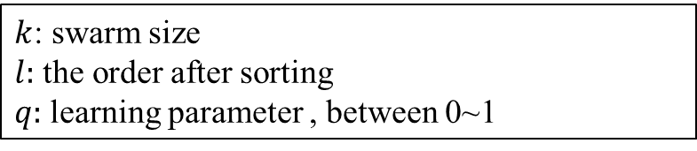
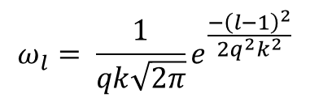
Ant Colony Optimization
Form $k$ solutions (ants) randomly
$$ω_{l}= \frac{1}{qk\sqrt{2π}}e^{\frac{−{\left(l−1\right)}^{2}}{2q^{2}k^{2}}}$$
Calculate the cost and sort
$k$: swarm size
$l:$ the order after sorting
$q:$ learning parameter , between 0~1
Calculate the weight $ω_{l}$

Slide 10

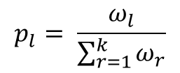
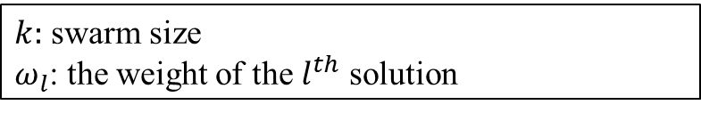
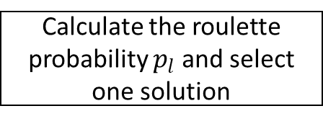
Ant Colony Optimization
Form $k$ solutions (ants) randomly
$$p_{l}= \frac{ω_{l}}{\sum_{r=1}^{k}{ω_{r}}}$$
Calculate the cost and sort
$k:$ swarm size
$ω_{l}$: the weight of the $l^{th}$ solution
Calculate the weight $ω_{l}$
Calculate the roulette probability $p_{l}$ and select one solution

Slide 11
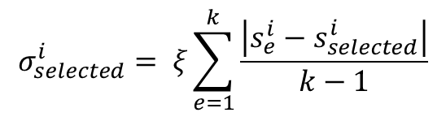
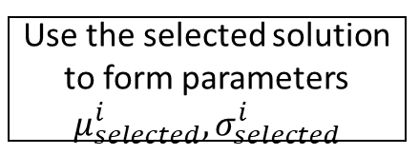
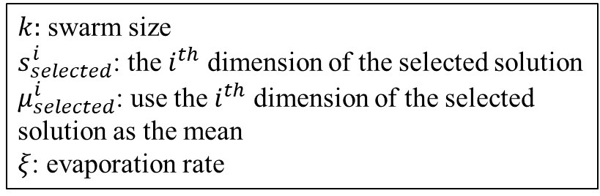
Ant Colony Optimization
Form $k$ solutions (ants) randomly
$$σ_{selected}^{i}= ξ\sum_{e=1}^{k}{\frac{\left|s_{e}^{i}−s_{selected}^{i}\right|}{k−1}}$$
Calculate the cost and sort
$k:$ swarm size
$s_{selected}^{i}$: the $i^{th}$ dimension of the selected solution
$μ_{selected}^{i}$: use the $i^{th}$ dimension of the selected solution as the mean
$ξ$: evaporation rate
Calculate the weight $ω_{l}$
Calculate the roulette probability $p_{l}$ and select one solution
Use the selected solution to form parameters $μ_{selected}^{i},σ_{selected}^{i}$

Slide 12
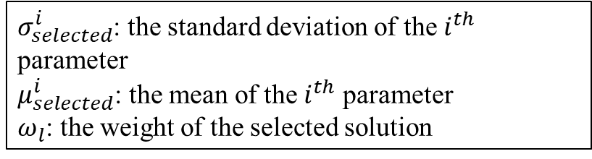
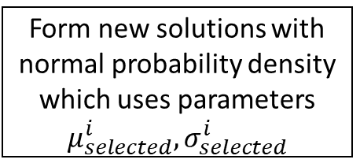

Ant Colony Optimization
Form $k$ solutions (ants) randomly
$$G^{i}\left(x\right)= ω_{l}\frac{1}{σ_{selected}^{i}\sqrt{2π}}e^{\frac{−{\left(x−μ_{selected}^{i}\right)}^{2}}{2{σ_{selected}^{i}}^{2}}}$$
Calculate the cost and sort
Replace the worst solutions with new solutions
$σ_{selected}^{i}$: the standard deviation of the $i^{th}$ parameter
$μ_{selected}^{i}$: the mean of the $i^{th}$ parameter
$ω_{l}$: the weight of the selected solution
Form new solutions with normal probability density which uses parameters $μ_{selected}^{i},σ_{selected}^{i}$
Calculate the weight $ω_{l}$
*This study replace the 50% worst solution with new solution.
Calculate the roulette probability $p_{l}$ and select one solution
Use the selected solution to form parameters $μ_{selected}^{i},σ_{selected}^{i}$

Slide 13
Machine Learning
Bee Colony Optimization

Slide 14
Bee Colony Optimization
Randomly form position of employed bees
Employed bee: To search the food source and provide the position.
Onlooker bee: To search the position by the food source provided by employed bee.
Scout bee: If the employed bee can’t find the better position, the scout bee would replace it and search randomly position to find the new food source.
Update the position of employed bees
Assign a scout bee to replace the position of the employed bee
Use roulette method to decide the position which onlooker bees would search around
Yes
No
Reach the limit?

Slide 15
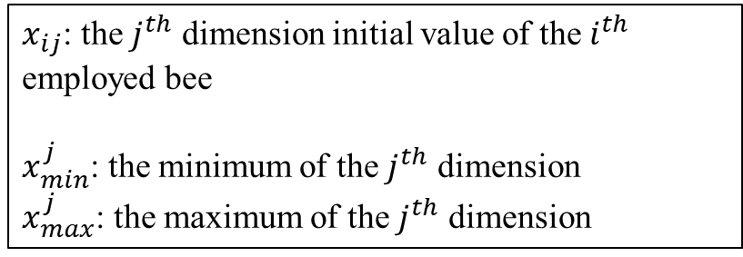
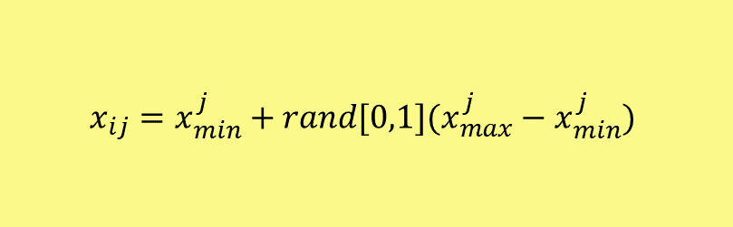
Bee Colony Optimization
Randomly form position of employed bees
$$x_{ij}=x_{min}^{j}+rand[0,1](x_{max}^{j}−x_{min}^{j})$$
$x_{ij}$: the $j^{th}$ dimension initial value of the $i^{th}$ employed bee
$x_{min}^{j}$: the minimum of the $j^{th}$ dimension
$x_{max}^{j}$: the maximum of the $j^{th}$ dimension

Slide 16
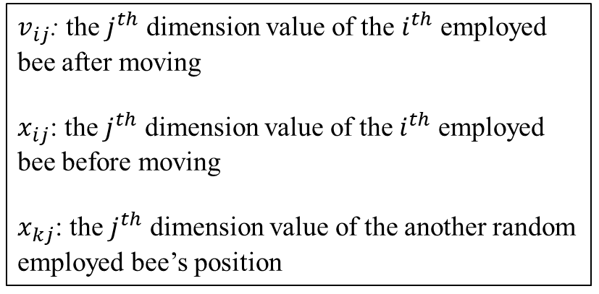
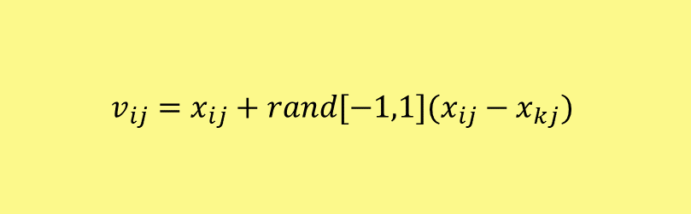
Bee Colony Optimization
Randomly form position of employed bees
$$v_{ij}=x_{ij}+rand[−1,1](x_{ij}−x_{kj})$$
Update the position of employed bees
$v_{ij}$: the $j^{th}$ dimension value of the $i^{th}$ employed bee after moving
$x_{ij}$: the $j^{th}$ dimension value of the $i^{th}$ employed bee before moving
$x_{kj}$: the $j^{th}$ dimension value of the another random employed bee’s position

Slide 17
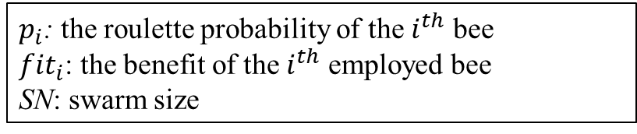

Bee Colony Optimization
Randomly form position of employed bees
$$p_{i}=\frac{fit_{i}}{\sum_{n=1}^{SN}{fit_{n}}}$$
Update the position of employed bees
$p_{i}$: the roulette probability of the $i^{th}$ bee
${fit}_{i}$: the benefit of the $i^{th}$ employed bee
SN: swarm size
Use roulette method to select a position

Slide 18
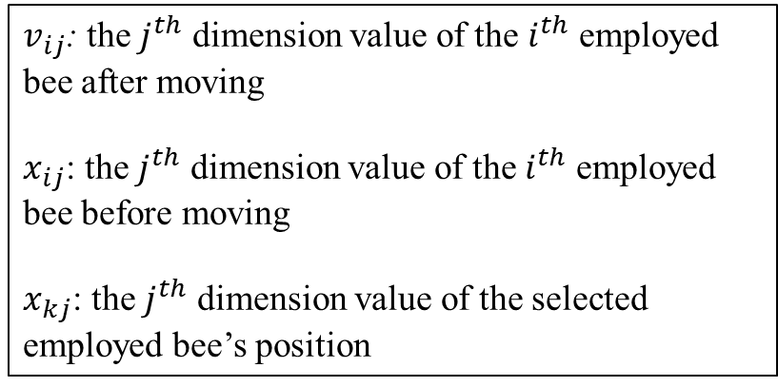
Bee Colony Optimization
Randomly form position of employed bees
$$v_{ij}=x_{ij}+rand[−1,1](x_{ij}−x_{kj})$$
Update the position of employed bees
$v_{ij}$: the $j^{th}$ dimension value of the $i^{th}$ employed bee after moving
$x_{ij}$: the $j^{th}$ dimension value of the $i^{th}$ employed bee before moving
$x_{kj}$: the $j^{th}$ dimension value of the selected employed bee’s position
Use roulette method to select a position
Onlooker bees search around the selected bee

Slide 19
Bee Colony Optimization
Randomly form position of employed bees
$$x_{ij}=x_{min}^{j}+rand[0,1](x_{max}^{j}−x_{min}^{j})$$
Update the position of employed bees
Assign a scout bee to replace the position of the employed bee
$x_{ij}$: the $j^{th}$ dimension initial value of the $i^{th}$ employed bee
$x_{min}^{j}$: the minimum of the $j^{th}$ dimension
$x_{max}^{j}$: the maximum of the $j^{th}$ dimension
Use roulette method to select a position
Yes
Onlooker bees search around the selected bee
No
*In this study we use the 20% overall iteration as the limit of each employed bee
Reach the limit?

Slide 20
Result

Slide 21
Data
Experimentation1
Experimentation1
 | Training | Testing
DJIA | 01/05/2001-9/30/2001 | 10/01/2001~01/03/2002
NASDAQ | 01/05/2001-9/30/2001 | 10/01/2001~01/03/2002
S&P500 | 01/05/2001-9/30/2001 | 10/01/2001~01/03/2002
RUSSELL 2000 | 01/05/2001-9/30/2001 | 10/01/2001~01/03/2002
181
66

Slide 22
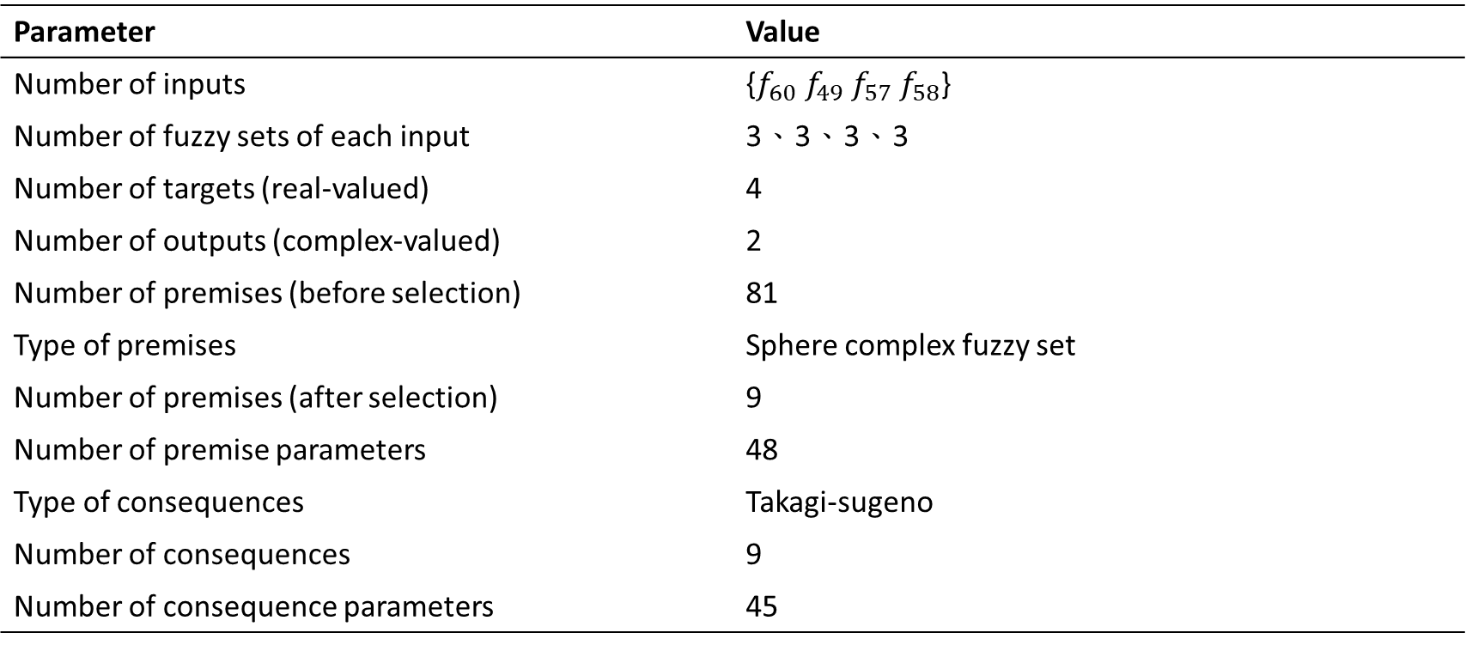
Result
Experimentation1
Parameter | Value
Number of inputs | {$f_{60} f_{49} f_{57} f_{58}$}
Number of fuzzy sets of each input | 3、3、3、3
Number of targets (real-valued) | 4
Number of outputs (complex-valued) | 2
Number of premises (before selection) | 81
Type of premises | Sphere complex fuzzy set
Number of premises (after selection) | 9
Number of premise parameters | 48
Type of consequences | Takagi-sugeno
Number of consequences | 9
Number of consequence parameters | 45

Slide 23
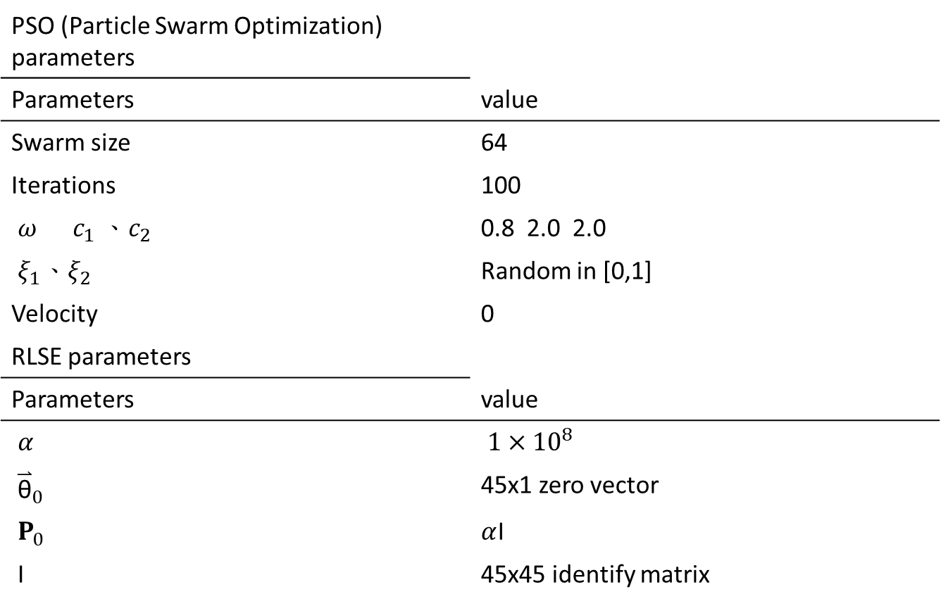
Experimentation1
PSO (Particle Swarm Optimization) parameters
Parameters | value
Swarm size | 64
Iterations | 100
$ω c_{1} 、c_{2}$ | 0.8 2.0 2.0
$ξ_{1}、ξ_{2}$ | Random in [0,1]
Velocity | 0
RLSE parameters
Parameters | value
$α$ | ${1×10}^{8}$
${\overset{⃑}{\text{θ}}}_{0}$ | 45x1 zero vector
$P_{0}$ | $α$I
I | 45x45 identify matrix

Slide 24
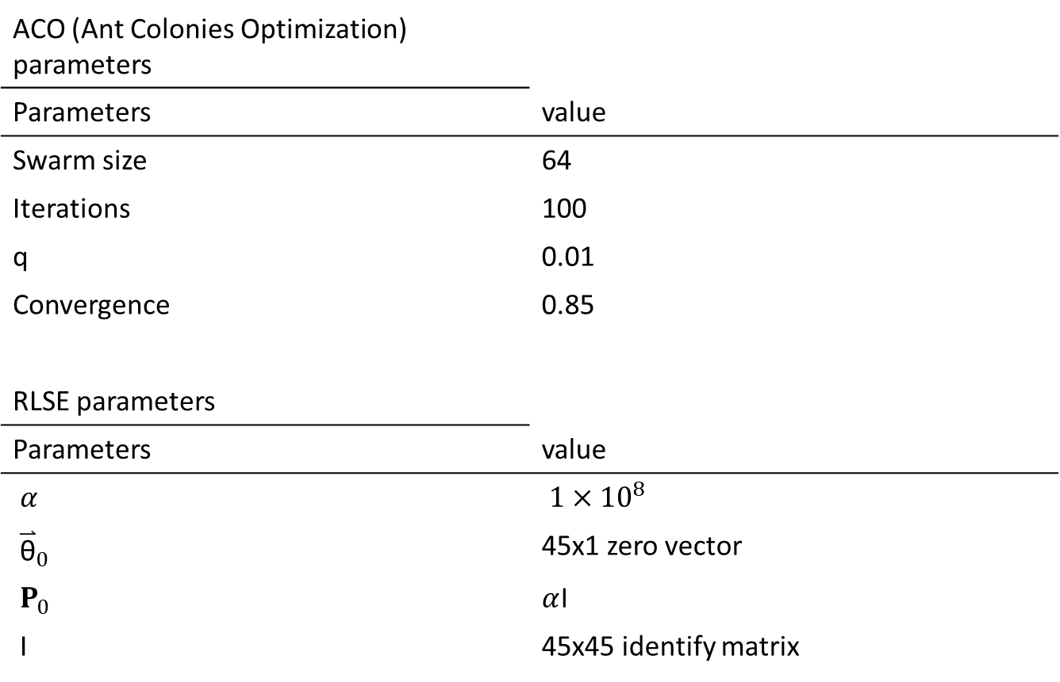
Experimentation1
ACO (Ant Colonies Optimization) parameters
Parameters | value
Swarm size | 64
Iterations | 100
q | 0.01
Convergence | 0.85
RLSE parameters
Parameters | value
$α$ | ${1×10}^{8}$
${\overset{⃑}{\text{θ}}}_{0}$ | 45x1 zero vector
$P_{0}$ | $α$I
I | 45x45 identify matrix

Slide 25
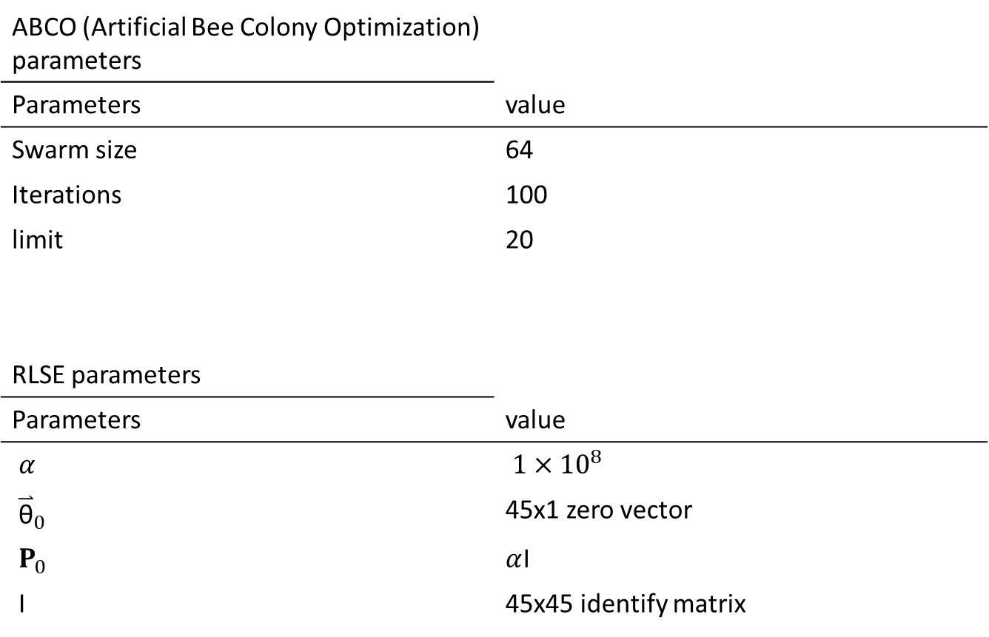
Experimentation1
ABCO (Artificial Bee Colony Optimization) parameters
Parameters | value
Swarm size | 64
Iterations | 100
limit | 20
RLSE parameters
Parameters | value
$α$ | ${1×10}^{8}$
${\overset{⃑}{\text{θ}}}_{0}$ | 45x1 zero vector
$P_{0}$ | $α$I
I | 45x45 identify matrix

Slide 26
PSO

Slide 27
PSO

Slide 28
ACO

Slide 29
ACO

Slide 30
BCO

Slide 31
BCO

Slide 32
Errors figure
PSO
ACO
ABCO

Slide 33
RMSE
 | RMSE (PSO)
1 | 360.7
2 | 265.63
3 | 323.88
4 | 326.38
5 | 264.79
6 | 360.71
7 | 265.63
8 | 323.88
9 | 326.38
10 | 264.79
 | RMSE (ACO)
1 | 319.48
2 | 264.04
3 | 343.19
4 | 438.39
5 | 271.97
6 | 376.43
7 | 715.81
8 | 438.00
9 | 366.13
10 | 312.87
 | RMSE (ABCO)
1 | 338.87
2 | 260.53
3 | 264.33
4 | 271.51
5 | 263.07
6 | 276.07
7 | 262.17
8 | 265.38
9 | 264.24
10 | 268.66

Slide 34
Comparison
Experimentation1
Method | RMSE (best)
PSO | 264.79
ACO | 264.04
ABCO | 260.53

Slide 35
END

